Slide 1

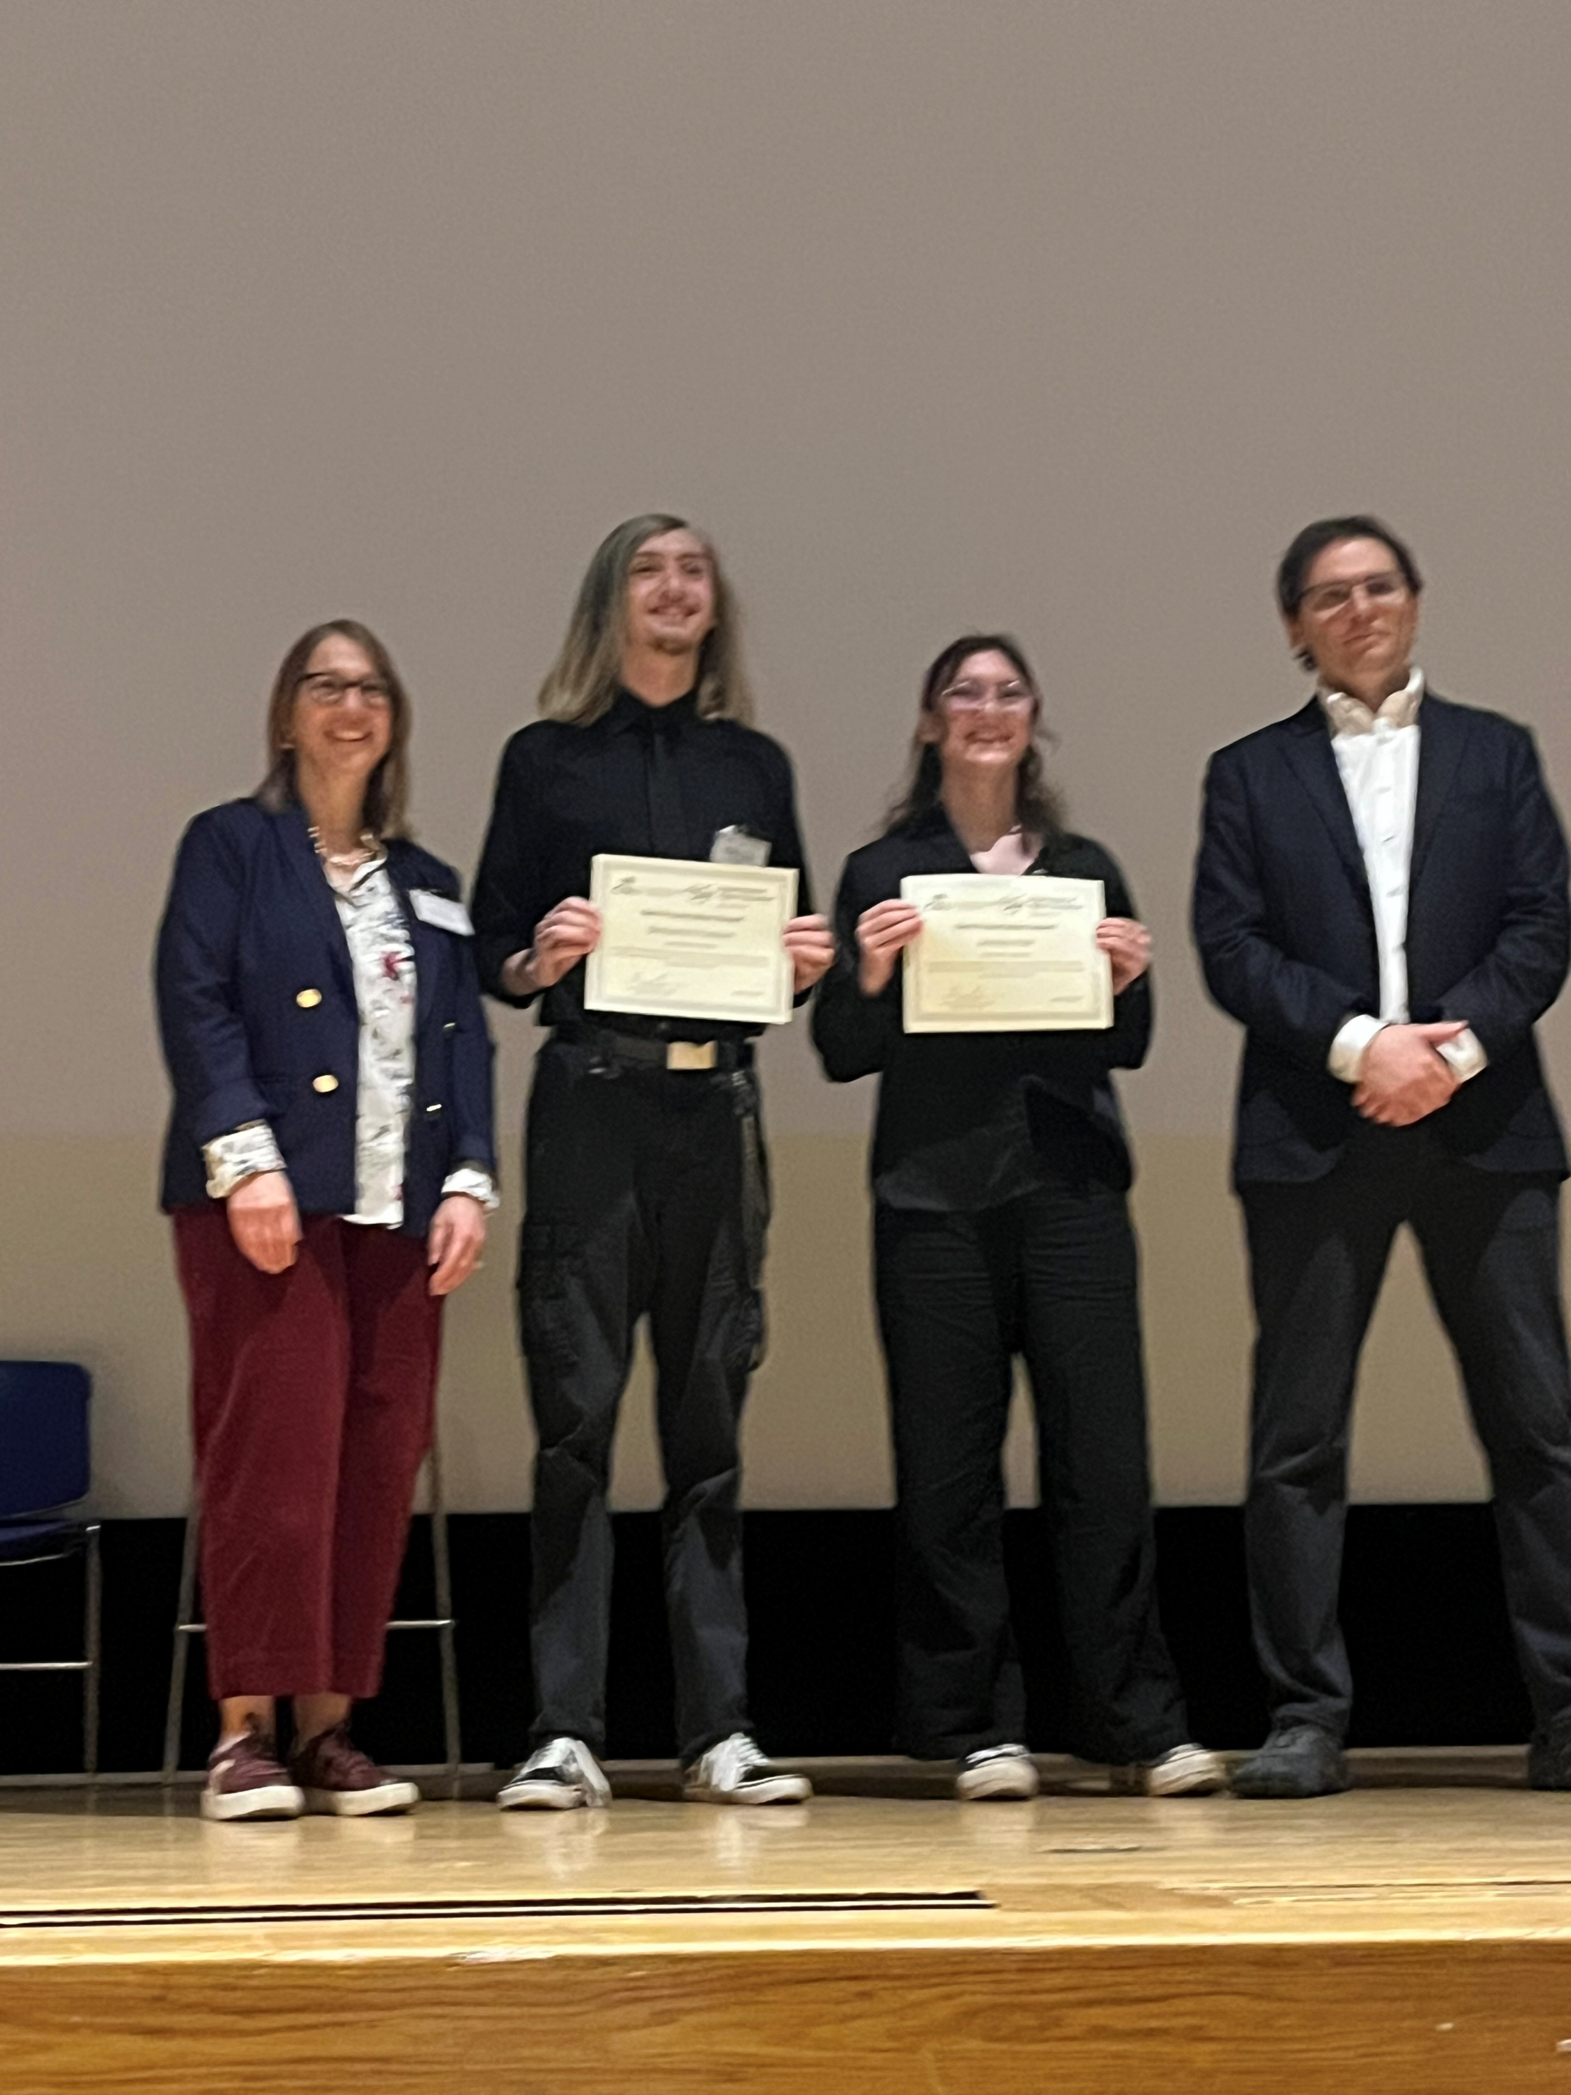
2026 COF Research Poster Conference
Best Poster Award
Ben Purdum, Annika Hall
Advisor: Dr. Raiful Hasan

Slide 2
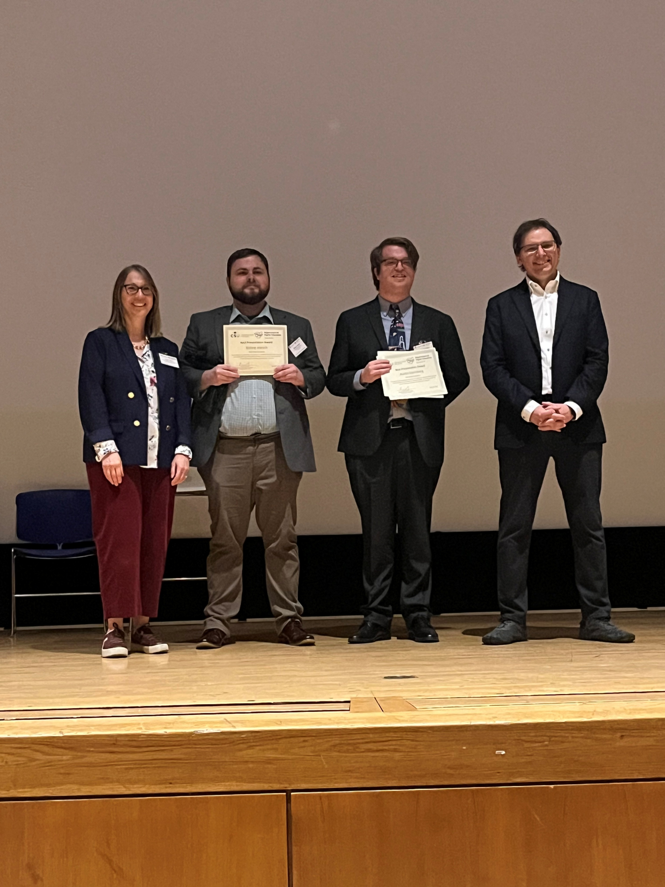
2026 COF Research Poster Conference
Best Poster Award
Bishop Harsch, Austin Sternberg
Advisor: Dr. Jong Yoon Kim

Slide 3
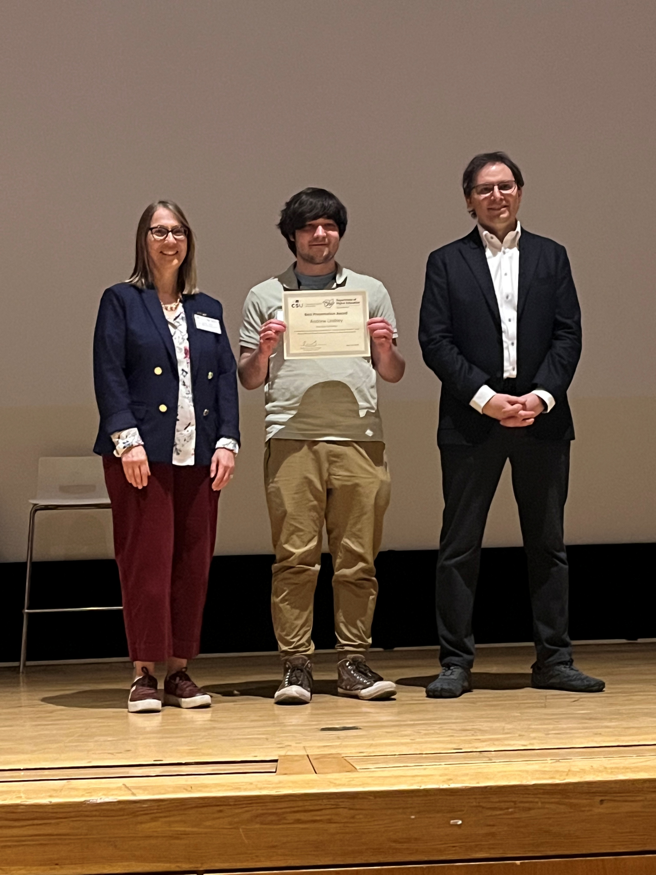
2026 COF Research Poster Conference
Best Poster Award
Andrew Lindsey
Advisor:
Dr. Javed Khan

Slide 4
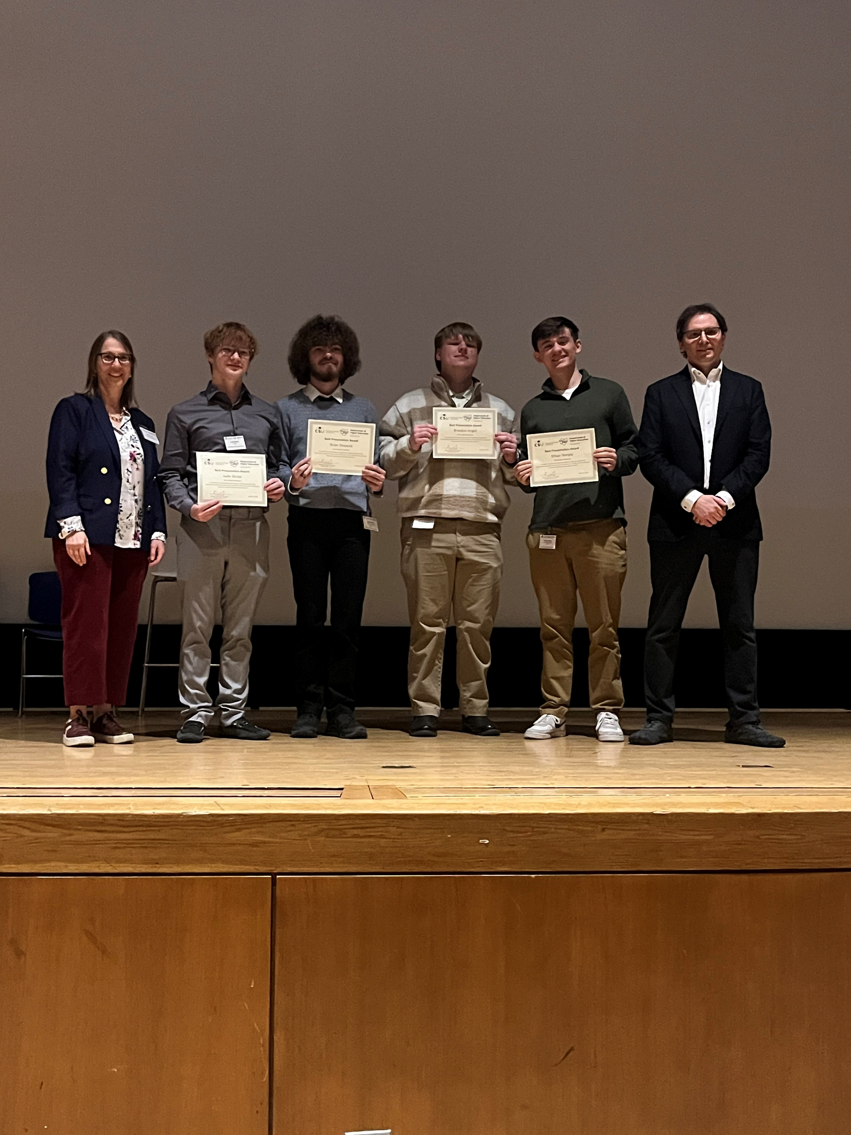
2026 COF Research Poster Conference
Best Poster Award
Brandon Angell, Jude Skrzat,
Ethan Temple, Brian Shepard
Advisor: Dr. Lei Xu

Slide 5
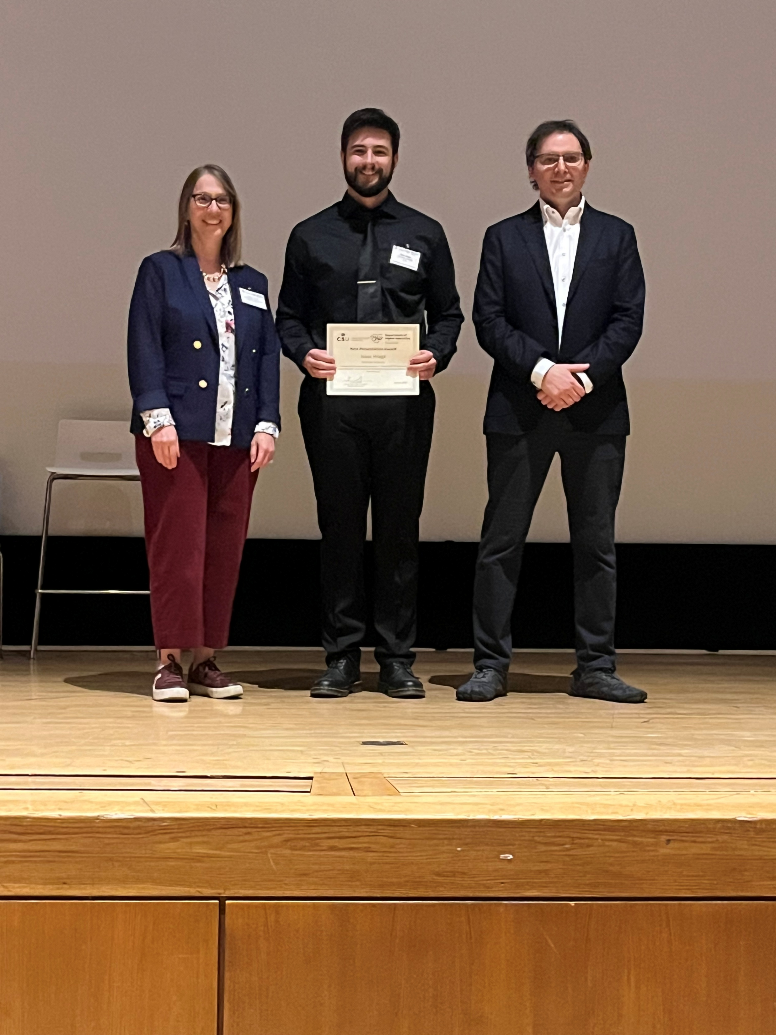
2026 COF Research Poster Conference
Best Poster Award
Isaac Hraga
Advisor:
Dr. Kwangtaek Kim

